Slide 1
CUI Training
CMMC Team

Slide 2
AGENDA
What is CUI?
Why Can’t our NU Email Handle CUI?
Where can I receive CUI?
How Do I get a GCC Account?
What DO I do If someone sends CUI to my NU account?
How Can I reduce CUI Spillage?

Slide 3
What is CUI?
Controlled Unclassified Information (CUI) is information about the US government that requires safeguarding. We want to keep national secrets safe from those who could do harm to the US.
There are government mandated rules and regulations around the kinds of systems and processes that must be in place to safely handle CUI.

Slide 4
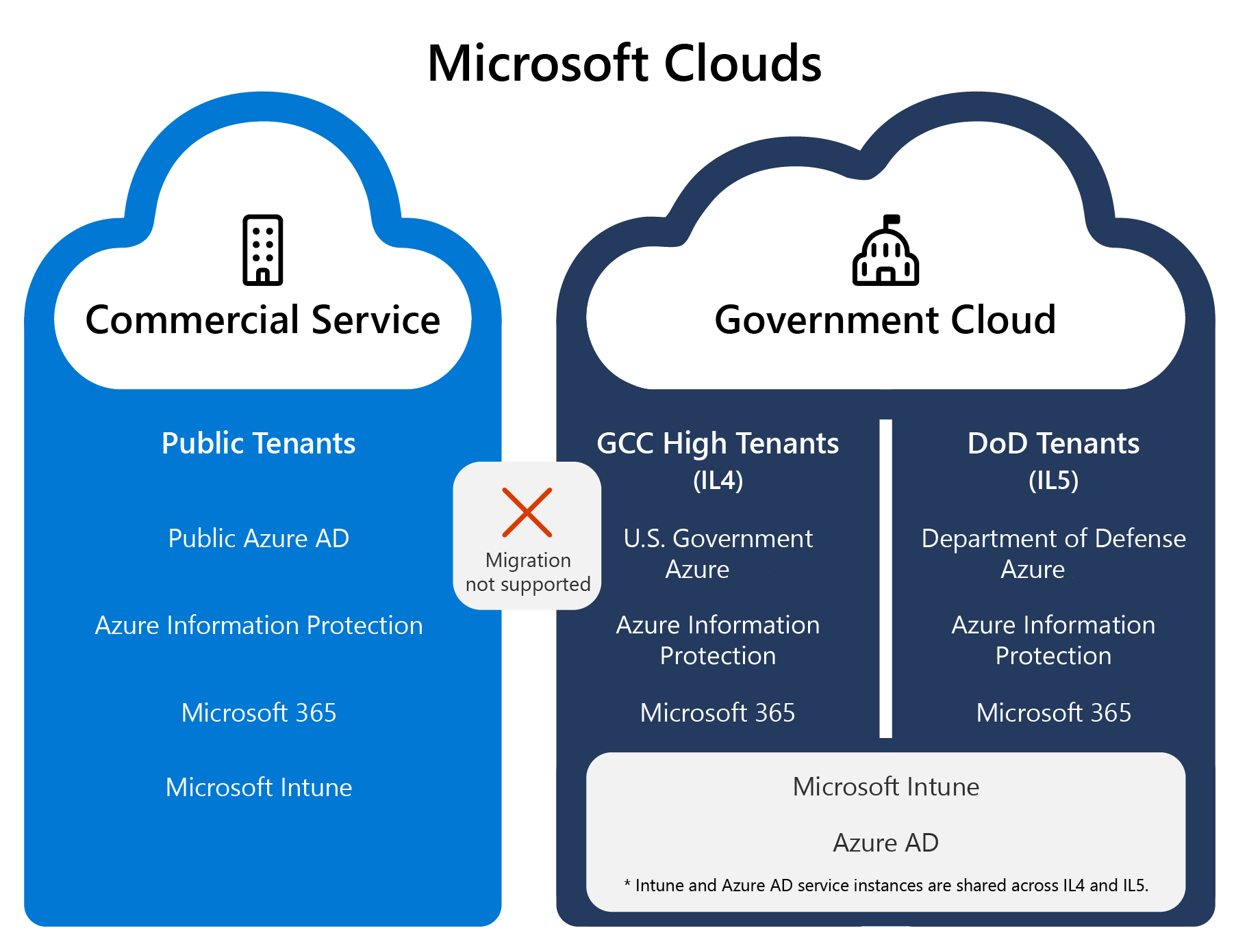
Why Can’t our NU Email Handle CUI?
Different Systems for Different Needs
Northeastern University has made the explicit decision to separate our email systems.
GCC High is the Microsoft platform we use to handle CUI. It is leveraged by multiple labs and departments across NU.
The Commercial Service is Microsoft’s platform for everyday users who do not have specific regulatory requirements. (@northeastern.edu)

Slide 5
Where can I receive CUI?
We have a CUI compliant information system called GCC High. This is a Microsoft 365 account where users can use all the same Office apps you use with your standard NU account, but in a system that is highly regulated and maintained for government compliance.
CUI Emails:
@gcc.northeastern.edu and @kri.northeastern.edu

Slide 6
How Do I get a GCC Account?
You must handle, or expect to handle CUI, on a semi-regular basis.
If you have a need for an account, you can reach out to the ISSO of the KRI, ECUAS, or SDE lab, the CMMC Program Manager, or Nu-Res to request one.
You must purchase a CUI compliant laptop or be assigned a VDI license. (We are in the process of testing and deploying the VDI licenses.)
We require US citizenship for all GCC accounts because of the possibility of NOFORN markings in the environment.

Slide 7
What DO I do If someone sends CUI to my NU account?
OIS will make sure to purge the information from our environment and confirm only authorized users accessed the file.
The user who originally discovered the spillage is usually leveraged throughout this process for information.
DO NOT FORWARD
Do not reply to the message or forward to anyone else.
Let everyone know in a separate email or Teams message to do the same.
Do not save it to any location (desktop, documents, OneDrive, or SharePoint)
NOTIFY
Email the CMMC team at the CMMC Program mailbox at cmmc_program_office@northeastern.edu.
Include the senders name, contact info, date and time sent, subject of email, and their company or government agency they work for.
CONFIRM
Confirm with the sender or the originator of the document that the information is truly CUI and not mismarked. Mismarking is common so it is vital to check first.
The CMMC PM will assist with this if needed.
Once the information is confirmed as CUI, the CMMC PM kicks off the incident response plan.
There is a 72 hours reporting requirement to let the government know we have had a spillage on a noncompliant system.
ANALYSIS AND RECOVERY
REPORT

Slide 8
How Can I reduce CUI Spillage?
Proactively let our external partners and government agencies know they cannot send CUI to any @northeastern.edu email address. The more of them that know, the fewer incidents we will have.
An official notice meant to be shared with those partners and agencies is making its way through a comms consult right now. More to come on that later.
Be on the lookout for data classification markings with emails and attachments you receive from external senders.

Slide 9
CMMC and CUI References
Report CUI Spillage SOP
https://northeastern.service-now.com/tech?id=kb_article_view&sysparm_article=KB000021896
CUI Incident Response Plan
https://northeastern.service-now.com/tech?id=kb_article_view&sysparm_article=KB000021595
CUI Onboarding SOP
https://northeastern.service-now.com/tech?id=kb_article_view&sysparm_article=KB000021582
CMMC User Agreement
https://northeastern.service-now.com/tech?id=kb_article_view&sysparm_article=KB000021594
CUI Handling and Management SOP
https://northeastern.service-now.com/tech?id=kb_article_view&sysparm_article=KB000021587
CUI Incident Response Policy
https://northeastern.service-now.com/tech?id=kb_article_view&sysparm_article=KB000021828
CUI Categories | National Archives

Slide 10
THANK YOU
Brad Wing
b.wing@northeastern.edu

