Slide 1
Research Payroll Certification Reports FY 2023
October 5th, 2023
NU-RES Finance – Fred Cromp

Slide 2
Agenda
Overview
Federal Regulations
Institutional Policy
Grant Monitoring
Annual Certification Process
Timeline
Research Payroll Certification Report
PI/Delegate Reviews
Revisions
Recertification Process
Resources

Slide 3
Overview
Salaries are the largest category of charges to federal grants. Since most faculty and the staff who work on sponsored projects are involved in multiple grants and other activities at the University, monitoring their effort on a regular basis is critical.
The Research Payroll Certification Report is the University’s primary means for complying with the federal regulations relating to effort certification. Certified reports are vital documents used during audits and agency reviews.
The University’s effort reporting process is project-based and relies on actual payroll charges on each project as the basis for the certification. NURES Finance generates the Research Payroll Certification reports on an annual basis and works closely with department key contacts to collect the certified reports.

Slide 4
Federal Regulations
As a recipient of federal funding, Northeastern University is required to comply with the CFR, Part 200-Uniform Administrative Requirements, Cost Principles, and Audit Requirements for Federal Awards (Uniform Guidance).
Section 200.430: Compensation for Personal Services
Contains the federal regulatory requirements for internal controls over documenting salary charges to Federal awards.
Provides standards for documentation of personnel expenses.
Implies that charges to Federal awards for salaries and wages must be based on records that accurately reflect the work performed.
And that these records must be supported by a system of internal control which provides reasonable assurance that the charges are accurate, allowable, and properly allocated.

Slide 5
Institutional Policy
It is University policy that while salary charges to sponsored projects are made initially based upon the planned or estimated workload of faculty and others, the actual effort of each individual working on sponsored projects must be monitored, with charges modified as necessary based on variances between the estimated and actual effort.
Payroll vs. Effort Distribution: A payroll distribution reflects the activities to which salary is charged in the payroll system. An effort distribution should reflect an individual’s activity regardless of where the salary is charged. NU effort reporting relies on actual payroll charges as the basis for the certification.
Policy on Effort Reporting

Slide 6
Grant Monitoring
Although the annual certification process provides the principal means for certifying that the payroll charges are reasonable and allocable, it is important to monitor the activity devoted to those projects on a regular basis.
Principal Investigators/Department Administrators should review payroll distribution reports for accuracy in a timely manner. PIs should receive these reports for review on a monthly basis, or quarterly at a minimum.
It is important that effort allocations and adjustments are routinely communicated and recorded in the University’s financial records (i.e. 5-ledger research index/fund).
Should an individual’s salary on the project require changes, submit timely Payroll Distribution Change (PDC) forms in order to make the corrections.
Track Key Personnel effort and cost-share requirements to ensure commitments are met.
Ensure payroll charges are in line with activity/personnel listed within Progress Reports.
Submit timely prior approval requests.

Slide 7
Annual Payroll Certification Process
Research Payroll Certification Reports are generated by NURES Finance from Cognos, following the September financial close. Each certification report will capture a summary of the payments made to employees based on paycheck dates from 7/1/2022 to 6/30/2023.
The reports are sent to key contacts in every college/department in early October.
Each key contact receives a single PDF package with their department’s certification reports.
Department key contacts distribute reports to individual PIs.
Principal Investigators or designated officials certify reports. If applicable, revisions are noted within the report (PDC backup is required).
Completed certifications are returned to NURES Finance by November 1st.
Overdue reports will be escalated to Deans on November 8th, and to Provost on November 15th.

Slide 8
Timeline

Slide 9
Research Payroll Certification Report
Reports include grant demographics, such as PI name, project title, project start/end dates, sponsor name, department, etc.
The PI name is derived from the main Banner grant code (G000XXXX). The department and division referenced in each report is derived from the index/fund.
One report is generated per index/fund for the entire fiscal year, each showing payroll charges based on pay check date.
Note: there may be multiple lines for employees with more than one position code. For example, a faculty member that received both academic year and off-contract summer salary.
Pages within each PDF package are organized by PI name, then grant code, then fund code.
Payroll charges under account code 62190 - Moving Expense at Hire, have been removed from the report.

Slide 10
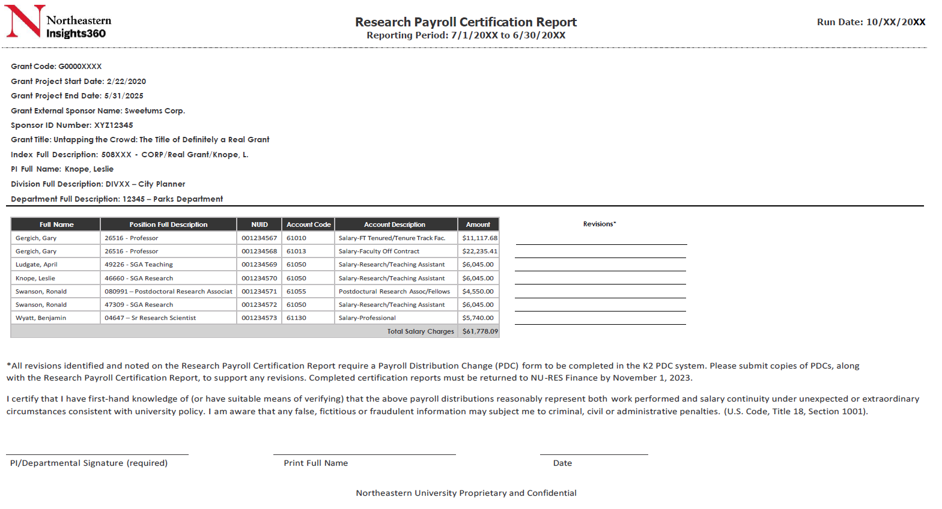
Research Payroll Certification Report

Slide 11
PI/Delegate Review
Who can certify?
The Principal Investigator (PI) or designated official is ultimately responsible to ensure that all salary charged to the project is commensurate with the employee’s effort on the project. If a PI is not available to certify the report, an individual having direct knowledge of the project, or suitable means of verification that the work was performed, may certify.
What is being certified?
That the payroll charges for the employees listed on the project index/fund, reasonably reflects the activity on the project for which the employee was compensated.
What is required if there are any changes or corrections needed on the report?
If a correction is needed, manually note the revisions within the payroll certification under the “Revisions” section.
Departments must compete a Payroll Distribution Change (PDC) form immediately, to update the payroll charges on the project. Attach copies of PDCs when returning the signed Payroll Certification.
Note: a detailed justification of the work performed and reason for the delay is required. RF will review justifications and determine if PDC can be approved.

Slide 12
Revisions - Example
Identify and note changes on the Research Payroll Certification Report → see Revisions section.
Process corresponding Payroll Distribution Change (PDC) forms in K2 system.
Submit copies of PDCs to NURES Finance, along with the Research Payroll Certification Report, to support revisions.

Slide 13
Submitting Certified Reports
Return all completed Research Payroll Certification Reports to Fred Cromp, f.cromp@northeastern.edu by November 1st.
Three ways to certify :
Print, sign, and scan
Sign electronically
Reply with “I certify” via email and include screenshot report in the body of email
*Incomplete certifications (i.e. manual revisions without copies of PDCs) will be returned to department contacts.

Slide 14
Recertification Process
PIs will be required to re-certify reports when payroll changes modify a closed certification period.
Recertification Example
PI certifies payroll report for the period 7/1/21 – 6/30/22 on 11/1/22.
On 12/1/22, a PDC dating back to 5/1/22 is processed, which modified payroll on grant 500123.
NURES Finance will generate an updated Payroll Certification Report for grant 500123 and distribute to department contacts for PI recertification.
Department contacts will return certified reports to NURES Finance within 15 days.
Note: Recertification process will not apply to payroll transfers between fund numbers under the same Banner Grant Code (G000XXXX).
Notes:
Not the norm

Slide 15
Resources
NU Policies:
Policy on Effort Reporting
Policy on Cost Transfers
Cognos:
FIN0032 – Payroll Distribution Report (Workday version)
FIN0036 – Payroll Distribution by Month (Workday version)
FIN0145 – Research Payroll Distribution - RESFIN (combines Banner and Workday data)
FIN0149 – Research Payroll Verification (RESFIN)
Additional information on commonly used reports can be found here: https://research.northeastern.edu/nu-res/lifecycle-management/manage-project/financial-monitoring-reporting/
PDCs:
K2 PDC Tips & Tricks
Submit a Costing Allocation Change or PDC

